Slide 1
Team 6 Group Project
SDEV 265 – 50P Fall 2023 Ryan Jarrett, Kacie Jordan, Drashaun Morrow, George Xiao

Slide 2
Supplemental Documents
Requirements Document
Feasibility Study
Project Plan
Risk Assessment
Design Document
User Documentation

Slide 3
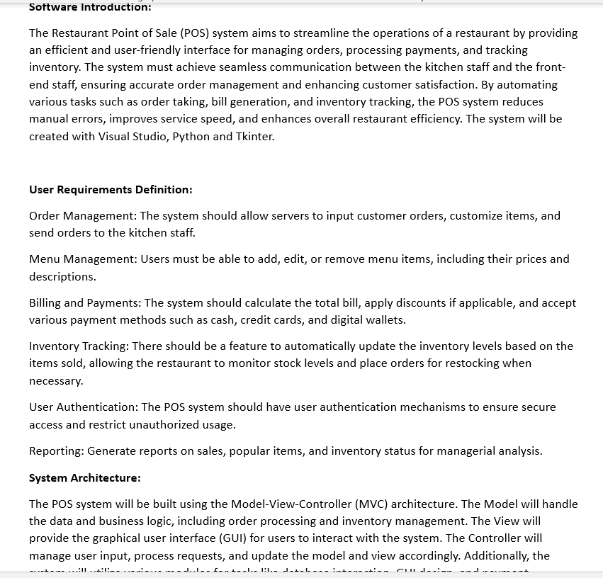
Requirements Document
The requirements document outlines the specifications for developing a restaurant menu application using Python with Tkinter, a popular GUI (Graphical User Interface) library. The purpose of this application is to provide an intuitive and user-friendly interface for both customers and restaurant staff to interact with the menu.

Slide 4
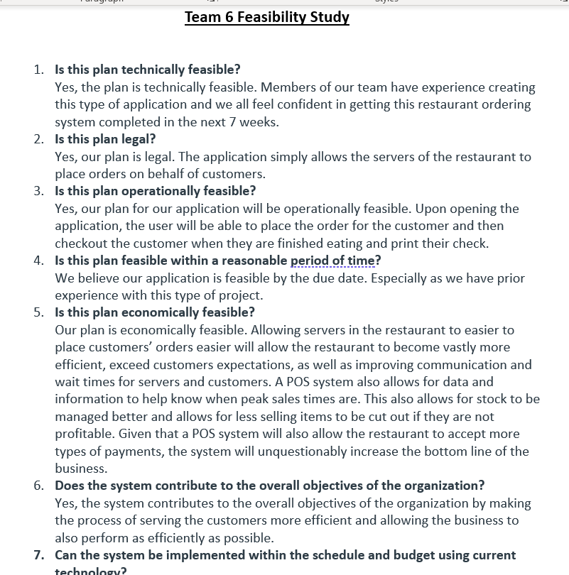
Feasibility Study
The feasibility study for our Python Tkinter-based restaurant menu program indicates a promising and viable solution for streamlining menu management and enhancing user experience within a restaurant setting. The study encompasses various aspects to assess the practicality, economic viability, and technical feasibility of implementing such a system.

Slide 5
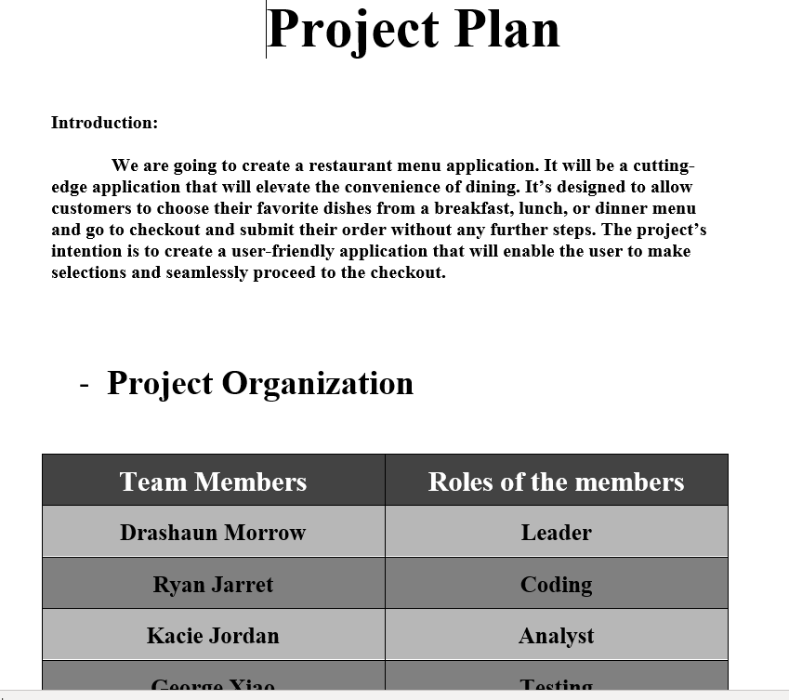
Project Plan
Create a user-friendly restaurant menu program using Python with Tkinter to provide an interactive interface for customers to view, select, and order items from the menu.

Slide 6
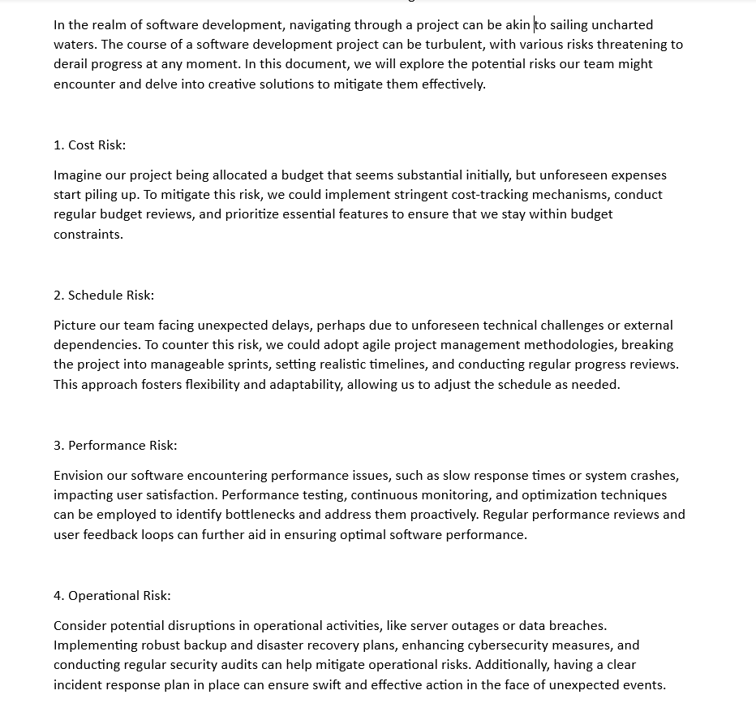
Risk Assessment
The Python Tkinter Restaurant Menu program poses several potential risks that need to be identified and mitigated to ensure the application's reliability, security, and overall performance.

Slide 7
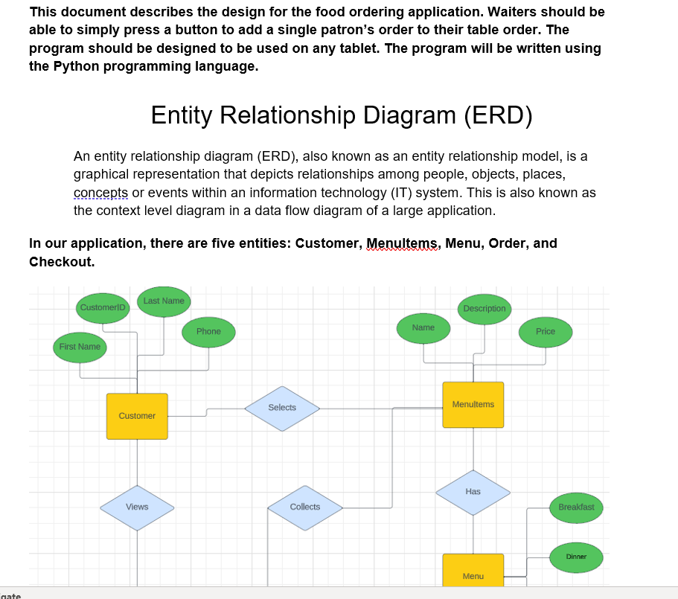
Design Document
The design document outlines the architecture and functionality of a restaurant menu application developed using Python with the Tkinter GUI toolkit. The program aims to provide an interactive and user-friendly interface for managing and displaying a restaurant menu.

Slide 8
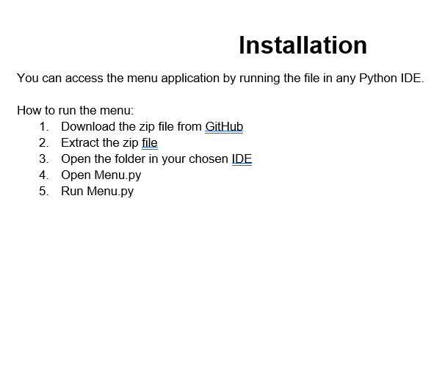
User Documentation
This user documentation provides a comprehensive guide to using our Python Tkinter-based Restaurant Menu program. The program is designed to assist restaurant owners and staff in managing and displaying a digital menu efficiently.

Slide 9
Project Summary Information
Our Python Tkinter Restaurant Menu and Ordering System is a user-friendly application designed to streamline the dining experience. With dynamic time-based menus, customers can easily view breakfast, lunch, or dinner options. The system allows effortless item selection, maintains a running total, and presents a detailed order summary. Customers can input their information for order tracking, enter payment details securely, and receive a final confirmation before completing the transaction. The Tkinter-based interface ensures a visually appealing and intuitive experience, benefiting both customers and restaurant staff. The project aims to enhance restaurant operations by providing a digital solution for efficient menu management, ordering, and customer interaction.

Slide 10
Tools Used
Visual Studio
GitHub
Discord
Trello
Google Docs

Slide 11
Component Summary
Successful – Menu based on current time that is displayed, “Add to Order”, “Send Order”, “Clear Order”, and “Back” buttons, Running total that keeps track of each item added to order, Send order confirmation, Order Summary with “Pay Now” button, Enter payment information with “Confirm Order” button, Application restarts upon confirmation
Attempts – We wanted back buttons on the order summary and payment information pages but were unable to get these working
Failures – We did not have the opportunity to add a design or theme but met all of our other goals

Slide 12
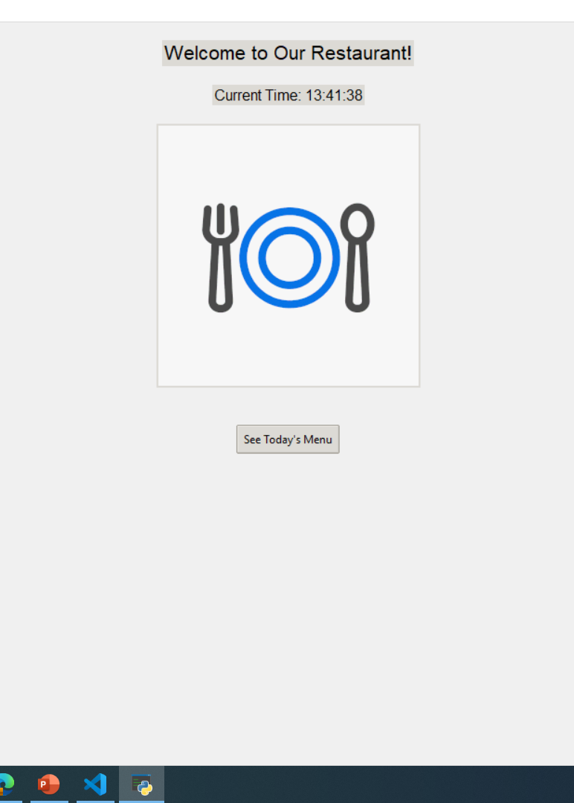
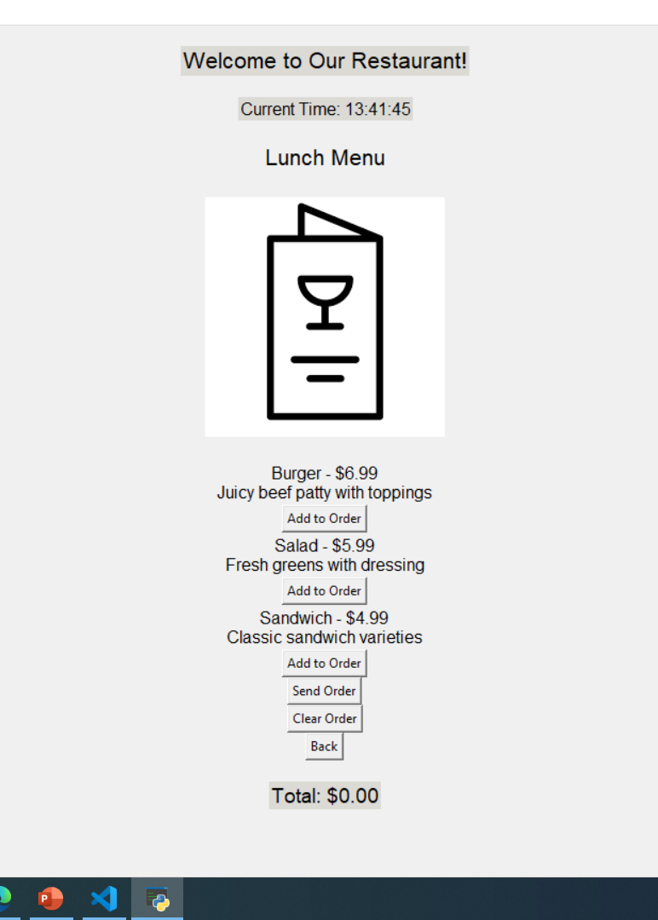
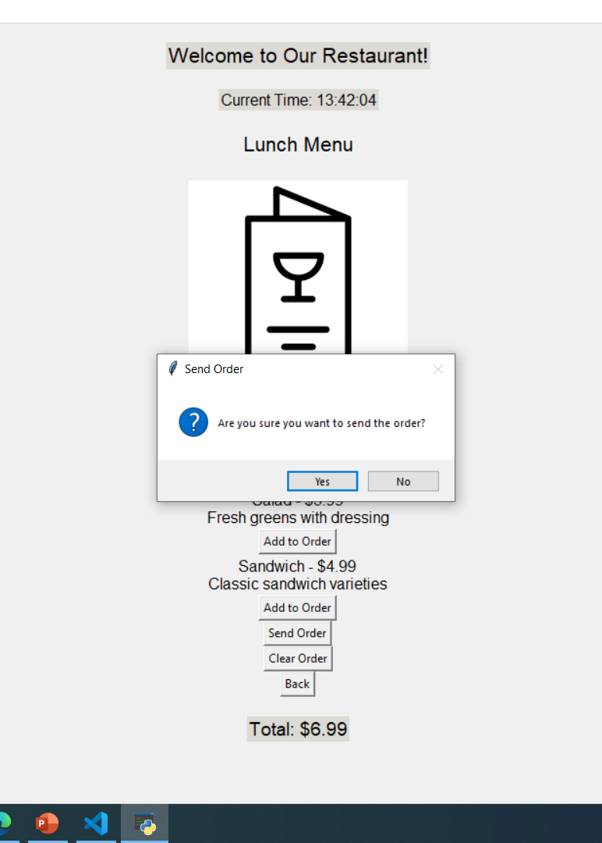
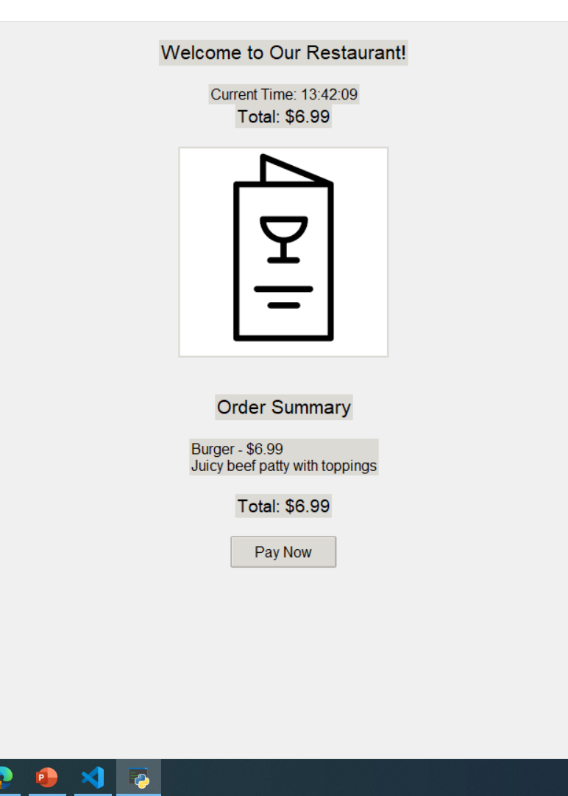
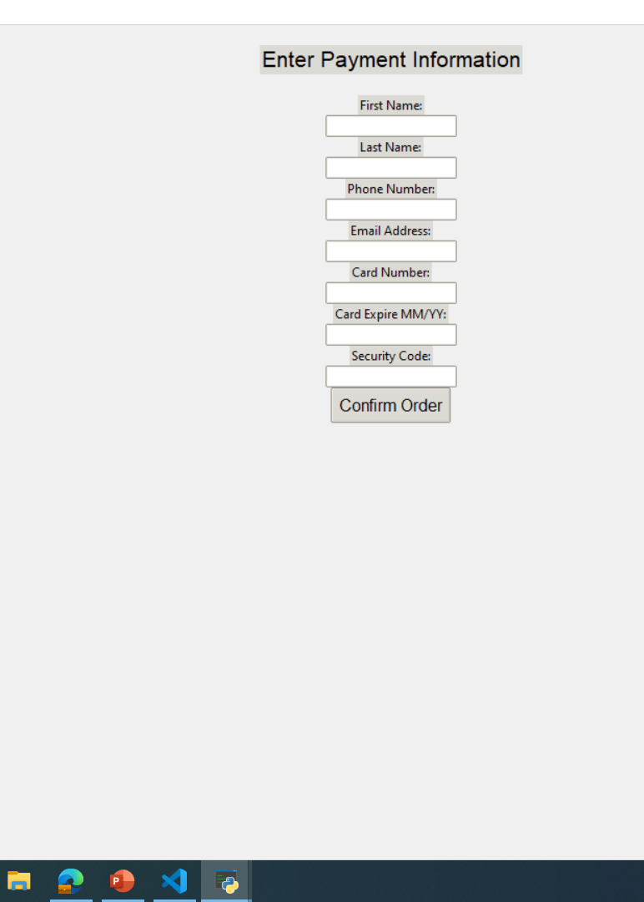
Running Application

Slide 13
Future Enhancements
Future enhancements for our Restaurant Menu and Ordering System could include the integration of user accounts for personalized experiences, seamless integration with Point of Sale (POS) systems for enhanced operational efficiency, a table reservation system for managing seating arrangements, multi-language support to cater to diverse customers, the introduction of discounts and promotions for customer engagement, a feedback and rating system for continuous improvement, Kitchen Display System (KDS) integration for real-time communication between kitchen and front-of-house, mobile app compatibility for on-the-go ordering, and the implementation of analytics tools to gather insights on customer preferences and operational trends. Additionally, customizable themes and branding options could be explored to provide a more tailored and visually appealing interface for both customers and restaurant staff.

Slide 14
Questions and Answers
Q: Can customers modify or cancel their orders after confirmation?
A: Once an order is confirmed, the system does not currently support direct modifications or cancellations. However, customers can contact the restaurant directly to discuss any necessary changes or cancellations. Future enhancements might include a user account system that allows customers to manage their orders within a specified timeframe.
Q: Can the restaurant staff view detailed analytics and reports using the system?
A: Currently, the system does not include an analytics and reporting feature. However, a future enhancement could involve implementing analytics tools to provide the restaurant staff with insights into popular menu items, peak ordering times, and customer preferences, aiding strategic decision-making.
Q: How does the program handle security for customer payment information?
A: The system takes security seriously and ensures the secure entry of payment information. It utilizes encryption protocols to protect customer data during the transaction process. Implementing additional security measures, such as compliance with Payment Card Industry Data Security Standard (PCI DSS), could be considered in future updates to further enhance payment security.
Q: Is there a plan to add more customization options for the restaurant's branding in the future?
A: Yes, future enhancements may include customizable themes and branding options to allow restaurants to tailor the visual appearance of the interface according to their specific branding guidelines, providing a more personalized experience for both customers and staff.

